Slide 1
Turing Machines
again

Slide 2
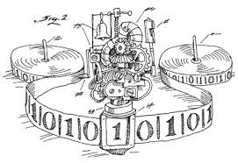
Turing Machines (again)
A turing machine is a simple form of a computer that reads and manipulates a string of symbols according to a predefined set of rules.
It consists of a Reader, a Writer and a Tape.

Slide 3
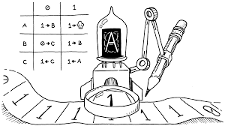
What must a Turing Machine do?
Read memory
Write to memory
Move to another memory location
Read and process an instruction
Go to the next instruction

Slide 4
What must a Turing Machine do?
Read memory
Write to memory
Move to another memory location
Read and process an instruction
Go to the next instruction
These are written on the strip of tape (memory)
These rules are kept separately from the tape.

Slide 5
What must a Turing Machine do?
Turing machines allow:
An infinite length of tape
BUT only a finite set of instructions
In this sense, they are a theoretical construct

Slide 6
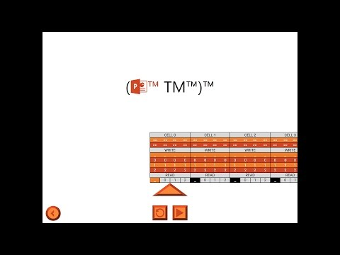

Slide 7


Slide 8

Algorithms…. revisited
What is an algorithm?

Slide 9
Algorithms…. revisited
What is an algorithm?
a sequence of operations that can be performed by a Turing Machine!

Slide 10
The Church-Turing Thesis
This leads us to the Church-Turing Thesis. Both men were independently trying to come up with a definition for what computable means. They did it quite differently but the result was the same:
If something is defined as being algorithmically computable, then that means it is able to be solved by a Turing Machine.

Slide 11
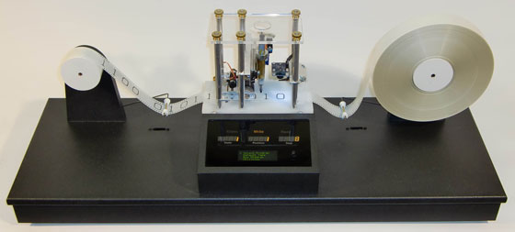
What is ‘computable’?
IF a problem can be solved by a Turing Machine… then it is computable!
The problem could be a decision problem (true/false), or a function problem (more complex outputs).

Slide 12
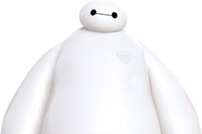
The Church-Turing Thesis
So are all problems computable?

Slide 13
The Church-Turing Thesis
So are all problems computable?
i.e. Are there any problems that we cannot solve with an algorithm?

Slide 14
The Church-Turing Thesis
So are all problems computable?
i.e. Are there any problems that we cannot solve with an algorithm?
i.e. Are there any problems that we cannot solve with a Turing Machine?
(remember, they have an infinite amount of memory!)

Slide 15
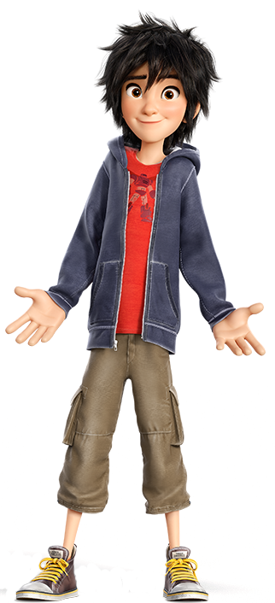
The halting problem
Now let’s take a look at the Halting Problem. Basically it goes something like this:
Is there a way that we can determine if a given algorithm will ever terminate or not?
seems simple huh?

Slide 16
The halting problem
Is there a way that we can determine if a given algorithm will ever terminate or not?
This is a decision problem (true/false)
Can a Turing machine compute the solution?
If so, then it is computable and decidable.
If not, then it is not computable and undecidable.

Slide 17
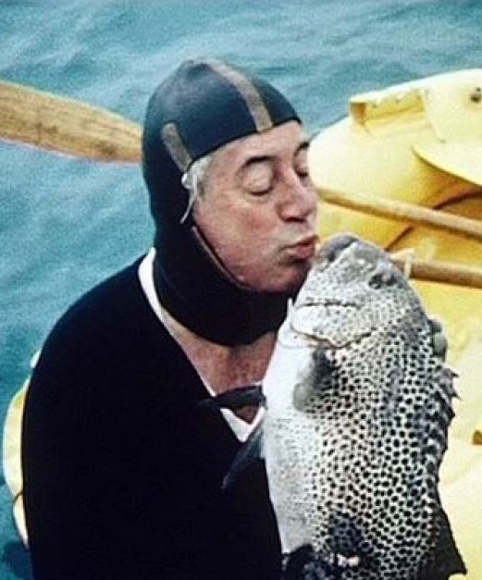
A proof that the Halting Problem is undecidable (abridged)
Geoffrey K. Pullum
(School of Philosophy, Psychology and Language Sciences, University of Edinburgh)
For imagine we have a procedure called P
that for specified input permits you to see
whether specified source code, with all of its faults,
defines a routine that eventually halts.
If there will be no looping, then P prints out ‘Good.’
That means work on this input will halt, as it should.
But if it detects an unstoppable loop,
then P reports ‘Bad!’ — which means you’re in the soup.
Harold Holt. Former Australian Prime Minister. Kissing a fish.

Slide 18


A proof that the Halting Problem is undecidable (abridged)
Geoffrey K. Pullum
(School of Philosophy, Psychology and Language Sciences, University of Edinburgh)
For imagine we have a procedure called P
that for specified input permits you to see
whether specified source code, with all of its faults,
defines a routine that eventually halts.
If there will be no looping, then P prints out ‘Good.’
That means work on this input will halt, as it should.
But if it detects an unstoppable loop,
then P reports ‘Bad!’ — which means you’re in the soup.
algorithm
Good
inputs
P
Bad

Slide 19
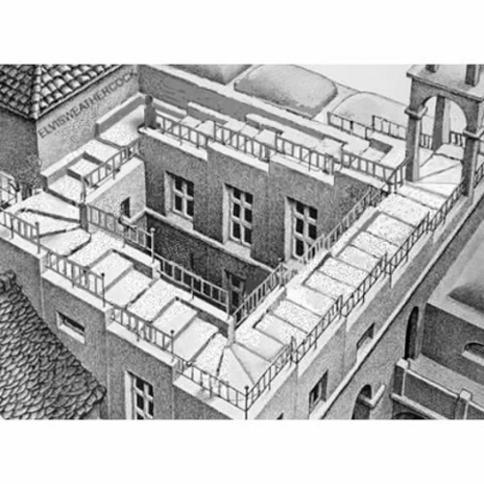
Well, the truth is that P cannot possibly be,
because if you wrote it and gave it to me,
I could use it to set up a logical bind
that would shatter your reason and scramble your mind.
Here’s the trick that I’ll use — and it’s simple to do.
I’ll define a procedure, which I will call Q,
that will use P’s predictions of halting success
to stir up a terrible logical mess.
If P’s answer is ‘Bad!’, Q will suddenly stop.
But otherwise, Q will go back to the top,
and start off again, looping endlessly back,
till the universe dies and turns frozen and black.

Slide 20
algorithm
Good
inputs
P
Bad

Slide 21
algorithm
Good
Q
inputs
P
Bad

Slide 22
algorithm
Good
Q
inputs
P

Slide 23
If Good then Loop
algorithm
Good
Q
inputs
P

Slide 24
algorithm
Q
inputs
P
P
Bad

Slide 25
algorithm
Q
inputs
P
P
Bad
If Bad then Halt

Slide 26
If Good then Loop
algorithm
Good
Q
Q
Q
Q
Q
inputs
P
Bad
If Bad then Halt

Slide 27
If Good then Loop
algorithm
Good
Q
Q
Q
Q
Q
inputs
P
Bad
If Bad then Halt
And this program called Q wouldn’t stay on the shelf;
I would ask it to forecast its run on itself.
When it reads its own source code, just what will it do?
What’s the looping behavior of Q run on Q?

Slide 28
If Good then Loop
Q
Good
Q
Q
Q
Q
Q
inputs
P
Bad
If Bad then Halt
And this program called Q wouldn’t stay on the shelf;
I would ask it to forecast its run on itself.
When it reads its own source code, just what will it do?
What’s the looping behavior of Q run on Q?

Slide 29
def Q(): if halts(Q): loop_forever()

Slide 30
def Q(): if halts(Q): loop_forever()
So does Q actually halt or not?

Slide 31
def Q(): if halts(Q): loop_forever()
We end up with a contradiction.
If it halts, then it will actually run in a neverending loop.
If it doesn’t halt, it will halt.
It is akin to saying - “This sentence is false”.

Slide 32
def Q(): if halts(Q): loop_forever()
It is by this argument that we can say that to determine if an algorithm will halt or not is Undecideable.

Slide 33

No matter how P might perform, Q will scoop it:
Q uses P’s output to make P look stupid.
Whatever P says, it cannot predict Q:
P is right when it’s wrong, and is false when it’s true!
So where can this argument possibly go?
I don’t have to tell you; I’m sure you must know.
A reductio: There cannot possibly be
a procedure that acts like the mythical P.
You can never find general mechanical means
for predicting the acts of computing machines;
it’s something that cannot be done. So we users
must find our own bugs. Our computers are losers!

Slide 34
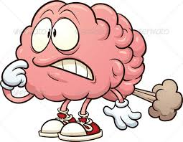

Slide 35
Brain Fart
Would you like to write a programming language from scratch?

Slide 36
Brain Fart
Would you like to write a programming language from scratch?
A programming language that is Turing complete?

Slide 37
Brain Fart
Would you like to write a programming language from scratch?
A programming language that is Turing complete?
A Turing complete language is a language that can simulate a Turing machine
And can therefore solve all computable problems!

Slide 38
Brain Fart
Brain Fart is a Turing complete language that only has 8 characters

Slide 39
Brain Fart
Brain Fart is a Turing complete language that only has 8 characters

Slide 40
Brain Fart
Brain Fart is a Turing complete language that only has 8 characters
> < + - . ? [ ]

Slide 41
Brain Fart
Here is Hello World! in Brain Fart:

Slide 42
Brain Fart
Here is Hello World! in Brain Fart:
++++++++[>++++[>++>+++>+++>+<<<<-]>+>+>->>+[<]<-]>>.>---.+++++++..+++.>>.<-.<.+++.------.--------.>>+.>++.

Slide 43
Brain Fart
It is only slightly modified from another esoteric language that has an unmentionably non-JMSS friendly name.

Slide 44
Brain Fart
It is only slightly modified from another esoteric language that has an unmentionably non-JMSS friendly name.
Which itself was only slightly modified from the P” programming language created by Corrado Böhm in 1964.

Slide 45
Brain Fart
Memory
0 | 0 | 0 | 0 | 0 | 0 | 0 | 0 | 0 | 0 | 0 | 0 | 0 | 0 | 0 | 0 | 0 | 0 | 0
data pointer
Program
+ | + | [ | > | + | + | [ | - | ] | ]
Instruction pointer

Slide 46
Brain Fart
Memory
0 | 0 | 0 | 0 | 0 | 0 | 0 | 0 | 0 | 0 | 0 | 0 | 0 | 0 | 0 | 0 | 0 | 0 | 0
data pointer
Program
+ | + | [ | > | + | + | [ | - | ] | ]
Instruction pointer
After an instruction is executed, the instruction pointer automatically moves to the next instruction on the right

Slide 47
Command | Meaning
> | increment the data pointer (to point to the next cell to the right).
< | decrement the data pointer (to point to the next cell to the left).
+ | increment (increase by one) the byte at the data pointer.
- | decrement (decrease by one) the byte at the data pointer.
. | output the byte at the data pointer.
? | accept one byte of input, storing its value in the byte at the data pointer.
[ | if the byte at the data pointer is zero, then instead of moving the instruction pointer forward to the next command, jump it forward to the command after the matching ] command.
] | if the byte at the data pointer is nonzero, then instead of moving the instruction pointer forward to the next command, jump it back to the command after the matching [ command.

Slide 48
Brain Fart
Memory
0 | 0 | 0 | 0 | 0 | 0 | 0 | 0 | 0 | 0 | 0 | 0 | 0 | 0 | 0 | 0 | 0 | 0 | 0
data pointer
Program
+ | + | [ | > | + | + | [ | - | ] | ]
Instruction pointer
After an instruction is executed, the instruction pointer automatically moves to the next instruction on the right

Slide 49
Brain Fart
Memory
1 | 0 | 0 | 0 | 0 | 0 | 0 | 0 | 0 | 0 | 0 | 0 | 0 | 0 | 0 | 0 | 0 | 0 | 0
data pointer
Program
+ | + | [ | > | + | + | [ | - | ] | ]
Instruction pointer
After an instruction is executed, the instruction pointer automatically moves to the next instruction on the right

Slide 50
Brain Fart
Memory
1 | 0 | 0 | 0 | 0 | 0 | 0 | 0 | 0 | 0 | 0 | 0 | 0 | 0 | 0 | 0 | 0 | 0 | 0
data pointer
Program
+ | + | [ | > | + | + | [ | - | ] | ]
Instruction pointer
After an instruction is executed, the instruction pointer automatically moves to the next instruction on the right

Slide 51
Brain Fart
Memory
2 | 0 | 0 | 0 | 0 | 0 | 0 | 0 | 0 | 0 | 0 | 0 | 0 | 0 | 0 | 0 | 0 | 0 | 0
data pointer
Program
+ | + | [ | > | + | + | [ | - | ] | ]
Instruction pointer
After an instruction is executed, the instruction pointer automatically moves to the next instruction on the right

Slide 52
Brain Fart
Memory
2 | 0 | 0 | 0 | 0 | 0 | 0 | 0 | 0 | 0 | 0 | 0 | 0 | 0 | 0 | 0 | 0 | 0 | 0
data pointer
Program
+ | + | [ | > | + | + | [ | - | ] | ]
Instruction pointer
After an instruction is executed, the instruction pointer automatically moves to the next instruction on the right

Slide 53
Brain Fart
Memory
2 | 0 | 0 | 0 | 0 | 0 | 0 | 0 | 0 | 0 | 0 | 0 | 0 | 0 | 0 | 0 | 0 | 0 | 0
data pointer
Program
+ | + | [ | > | + | + | [ | - | ] | ]
Instruction pointer
After an instruction is executed, the instruction pointer automatically moves to the next instruction on the right

Slide 54
Brain Fart
Memory
2 | 0 | 0 | 0 | 0 | 0 | 0 | 0 | 0 | 0 | 0 | 0 | 0 | 0 | 0 | 0 | 0 | 0 | 0
data pointer
Program
+ | + | [ | > | + | + | [ | - | ] | ]
Instruction pointer
After an instruction is executed, the instruction pointer automatically moves to the next instruction on the right

Slide 55
Brain Fart
Memory
2 | 0 | 0 | 0 | 0 | 0 | 0 | 0 | 0 | 0 | 0 | 0 | 0 | 0 | 0 | 0 | 0 | 0 | 0
data pointer
Program
+ | + | [ | > | + | + | [ | - | ] | ]
Instruction pointer
After an instruction is executed, the instruction pointer automatically moves to the next instruction on the right

Slide 56
Brain Fart
Memory
2 | 1 | 0 | 0 | 0 | 0 | 0 | 0 | 0 | 0 | 0 | 0 | 0 | 0 | 0 | 0 | 0 | 0 | 0
data pointer
Program
+ | + | [ | > | + | + | [ | - | ] | ]
Instruction pointer
After an instruction is executed, the instruction pointer automatically moves to the next instruction on the right

Slide 57
Command | Meaning
> | increment the data pointer (to point to the next cell to the right).
< | decrement the data pointer (to point to the next cell to the left).
+ | increment (increase by one) the byte at the data pointer.
- | decrement (decrease by one) the byte at the data pointer.
. | output the byte at the data pointer.
? | accept one byte of input, storing its value in the byte at the data pointer.
[ | if the byte at the data pointer is zero, then instead of moving the instruction pointer forward to the next command, jump it forward to the command after the matching ] command.
] | if the byte at the data pointer is nonzero, then instead of moving the instruction pointer forward to the next command, jump it back to the command after the matching [ command.

Slide 58
Brain Fart
See if you can code Brain Fart in Python!
Test it with the Hello World! program below:
++++++++[>++++[>++>+++>+++>+<<<<-]>+>+>->>+[<]<-]>>.>---.+++++++..+++.>>.<-.<.+++.------.--------.>>+.>++.

